Slide 1
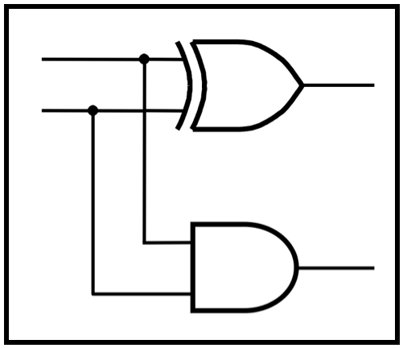
CprE 281:
Digital Logic
Instructor: Alexander Stoytchev
http://www.ece.iastate.edu/~alexs/classes/

Slide 2
Decoders and Encoders
CprE 281: Digital Logic
Iowa State University, Ames, IA
Copyright © Alexander Stoytchev

Slide 3
Administrative Stuff
HW 6 is due today

Slide 4
Administrative Stuff
HW 7 is out
It is due next Monday (Oct 17)

Slide 5
Administrative Stuff
Midterm Grades are Due this Friday
only grades of C-, D, F have to be submitted to the registrar’s office

Slide 6
Quick Review

Slide 7
Graphical Symbol for a 2-1 Multiplexer
s
x
0
1
f
x
1
2
[ Figure 2.33c from the textbook ]

Slide 8
Circuit for 2-1 Multiplexer
x
s
1
f
x
1
0
f
s
x
2
1
x
2
(b) Circuit
(c) Graphical symbol
f (s, x_{1,} x₂) =
s x₁
+
s x₂
[ Figure 2.33b-c from the textbook ]

Slide 9
The Three Basic Logic Gates
x
1
x
⋅
x
1
x
x
1
x
2
x
1
+
x
2
x
2
x
2
NOT gate
AND gate
OR gate
[ Figure 2.8 from the textbook ]

Slide 10
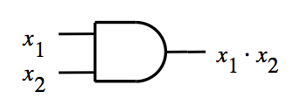
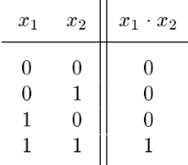
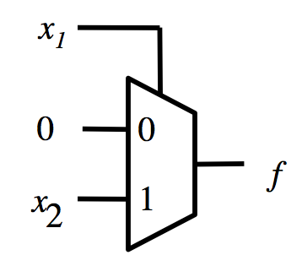
Building an AND Gate with 2-to-1 Mux
0
x₂

Slide 11
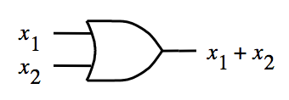
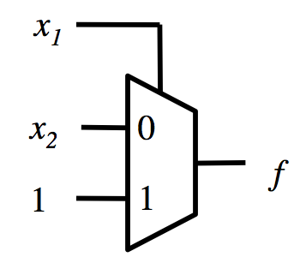
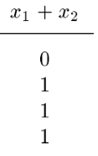
Building an OR Gate with 2-to-1 Mux
x₂
1

Slide 12
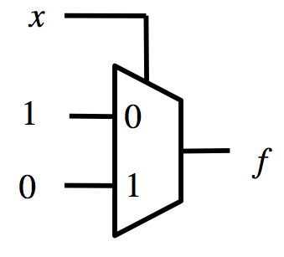
Building a NOT Gate with 2-to-1 Mux
x
x
x
x
0
1
1
0

Slide 13
Implications
Any Boolean function can be implemented
using only 2-to-1 multiplexers!

Slide 14
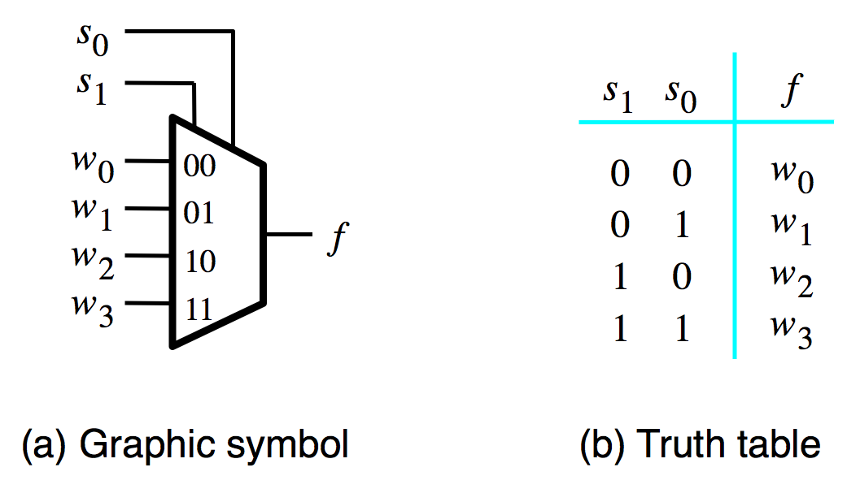
4-to-1 Multiplexer:
Graphical Symbol and Truth Table
[ Figure 4.2a-b from the textbook ]

Slide 15
The Three Basic Logic Gates
x
1
x
⋅
x
1
x
x
1
x
2
x
1
+
x
2
x
2
x
2
NOT gate
AND gate
OR gate
[ Figure 2.8 from the textbook ]

Slide 16
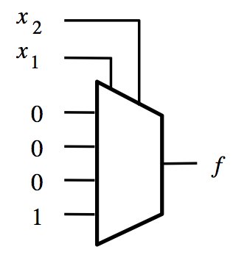
Building an AND Gate with 4-to-1 Mux

Slide 17
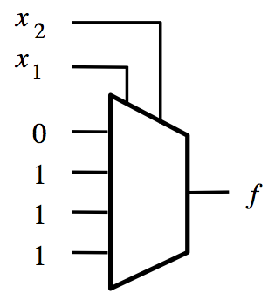
Building an OR Gate with 4-to-1 Mux

Slide 18
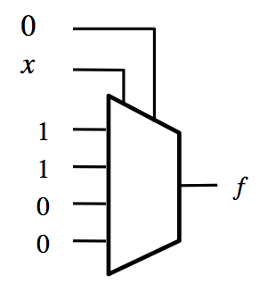
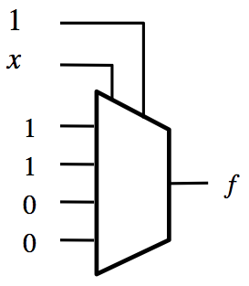
Building a NOT Gate with 4-to-1 Mux
x
x
x
x
0
1
1
0
Two alternative solutions.

Slide 19
Implications
Any Boolean function can be implemented
using only 4-to-1 multiplexers!

Slide 20
Using three 2-to-1 multiplexers
to build one 4-to-1 multiplexer
s
1
s
0
w
0
0
w
1
1
0
f
1
w
2
0
w
3
1
[ Figure 4.3 from the textbook ]

Slide 21
16-1 Multiplexer
s
0
s
1
w
0
w
3
w
4
s
2
s
3
w
7
f
w
8
w
11
w
12
w
15
[ Figure 4.4 from the textbook ]

Slide 22
Synthesis of Logic Circuits
Using Multiplexers

Slide 23
Implementation of a logic function with a 4x1 multiplexer
w
w
f
w
2
1
2
w
1
0
0
0
0
0
1
1
1
1
0
1
1
f
1
1
0
0
[ Figure 4.6a from the textbook ]

Slide 24
Implementation of the same logic function with a 2x1 multiplexer
w
1
w
2
f
w
f
1
w
0
0
0
w
1
0
2
0
1
1
w
w
1
2
2
1
0
1
f
1
1
0
(b) Modified truth table
(c) Circuit
[ Figure 4.6b-c from the textbook ]

Slide 25
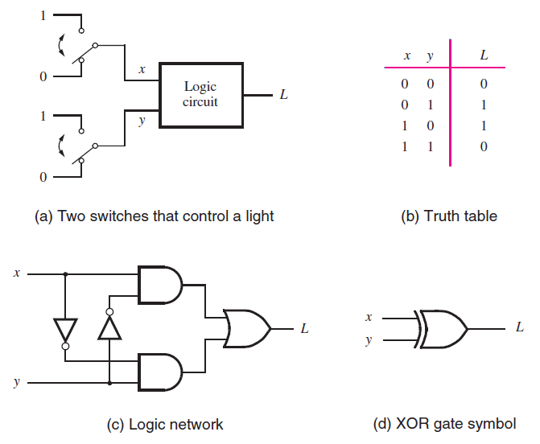
The XOR Logic Gate
[ Figure 2.11 from the textbook ]

Slide 26
The XOR Logic Gate
[ Figure 2.11 from the textbook ]

Slide 27
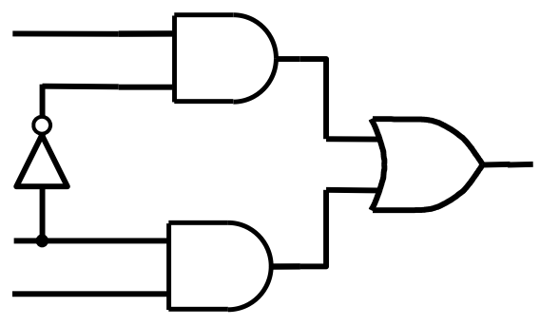
Implementation of the XOR Logic Gate with a 2-to-1 multiplexer and one NOT
f

Slide 28

Implementation of the XOR Logic Gate with a 2-to-1 multiplexer and one NOT
x
f
y

Slide 29
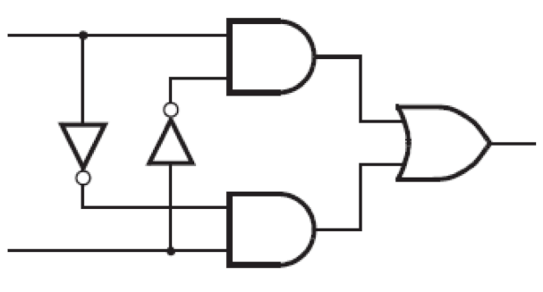
Implementation of the XOR Logic Gate with a 2-to-1 multiplexer and one NOT
x
f
y
These two circuits are equivalent
(the wires of the bottom AND gate are flipped)

Slide 30

In other words,
all four of these are equivalent!
x
y
f
x
f
y
w
2
w
1
x
0
1
f
y
f
1
0

Slide 31
Another Example
(3-input XOR)

Slide 32
Implementation of 3-input XOR with 2-to-1 Multiplexers
w
1
w
2
w
3
f
0
0
0
0
0
0
1
1
0
1
0
1
0
1
1
0
1
0
0
1
1
0
1
0
1
1
0
0
1
1
1
1
[ Figure 4.8a from the textbook ]

Slide 33
Implementation of 3-input XOR with 2-to-1 Multiplexers
w
1
w
2
w
3
f
0
0
0
0
0
0
1
1
w
⊕
w
0
1
0
1
2
3
0
1
1
0
1
0
0
1
1
0
1
0
w
⊕
w
1
1
0
0
2
3
1
1
1
1
[ Figure 4.8a from the textbook ]

Slide 34
Implementation of 3-input XOR with 2-to-1 Multiplexers
w
1
w
2
w
3
f
0
0
0
0
0
0
1
1
w
⊕
w
0
1
0
1
2
3
w
1
0
1
1
0
w
⊕
w
1
0
0
1
2
3
f
1
0
1
0
w
⊕
w
1
1
0
0
2
3
1
1
1
1
(a) Truth table
(b) Circuit
[ Figure 4.8 from the textbook ]

Slide 35
Implementation of 3-input XOR with 2-to-1 Multiplexers
w
1
w
2
w
3
f
0
0
0
0
w₃
0
0
1
1
w
0
1
0
1
w₃
2
w
1
0
1
1
0
w
3
1
0
0
1
f
1
0
1
0
1
1
0
0
1
1
1
1
(a) Truth table
(b) Circuit
[ Figure 4.8 from the textbook ]

Slide 36
Implementation of 3-input XOR
with a 4-to-1 Multiplexer
w
1
w
2
w
3
f
0
0
0
0
0
0
1
1
0
1
0
1
0
1
1
0
1
0
0
1
1
0
1
0
1
1
0
0
1
1
1
1
[ Figure 4.9a from the textbook ]

Slide 37
Implementation of 3-input XOR
with a 4-to-1 Multiplexer
w
1
w
2
w
3
f
0
0
0
0
0
0
1
1
0
1
0
1
0
1
1
0
1
0
0
1
1
0
1
0
1
1
0
0
1
1
1
1
[ Figure 4.9a from the textbook ]

Slide 38
Implementation of 3-input XOR
with a 4-to-1 Multiplexer
w
1
w
2
w
3
f
0
0
0
0
w
0
0
1
1
3
0
1
0
1
w
0
1
1
0
3
1
0
0
1
w
1
0
1
0
3
1
1
0
0
w
1
1
1
1
3
[ Figure 4.9a from the textbook ]

Slide 39
Implementation of 3-input XOR
with a 4-to-1 Multiplexer
w
1
w
2
w
3
f
0
0
0
0
w
0
0
1
1
3
w
2
w
1
0
1
0
1
w
0
1
1
0
3
w
3
1
0
0
1
w
f
1
0
1
0
3
1
1
0
0
w
1
1
1
1
3
(a) Truth table
(b) Circuit
[ Figure 4.9 from the textbook ]

Slide 40
Multiplexor Synthesis
Using Shannon’s Expansion

Slide 41
Three-input majority function
w
1
w
2
w
3
f
0
0
0
0
0
0
1
0
0
1
0
0
0
1
1
1
1
0
0
0
1
0
1
1
1
1
0
1
1
1
1
1
[ Figure 4.10a from the textbook ]

Slide 42
Three-input majority function
w
1
w
2
w
3
f
0
0
0
0
w
1
f
0
0
1
0
0
0
1
0
0
1
0
1
1
1
1
0
0
0
1
0
1
1
1
1
0
1
1
1
1
1
[ Figure 4.10a from the textbook ]

Slide 43
Three-input majority function
w
1
w
2
w
3
f
0
0
0
0
w
1
f
0
0
1
0
w
w
0
2
3
0
1
0
0
1
w
+
w
0
1
1
1
2
3
1
0
0
0
1
0
1
1
1
1
0
1
1
1
1
1
[ Figure 4.10a from the textbook ]

Slide 44
Three-input majority function
w
1
w
2
w
3
f
0
0
0
0
w
1
f
0
0
1
0
w
w
0
2
3
0
1
0
0
1
w
+
w
0
1
1
1
2
3
1
0
0
0
1
0
1
1
1
1
0
1
1
1
1
1
(b) Truth table
w
w
1
2
w
3
f
(b) Circuit
[ Figure 4.10a from the textbook ]

Slide 45

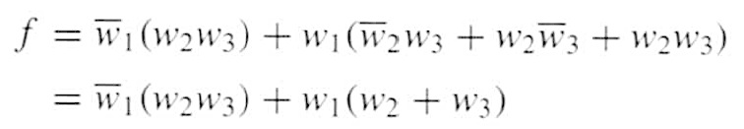
Three-input majority function
w
w
1
2
w
3
f

Slide 46

Shannon’s Expansion Theorem
Any Boolean function can be rewritten in the form:

Slide 47

Shannon’s Expansion Theorem
Any Boolean function can be rewritten in the form:

Slide 48
Shannon’s Expansion Theorem
Any Boolean function can be rewritten in the form:
cofactor
cofactor

Slide 49
Shannon’s Expansion Theorem
(Example)

Slide 50
Shannon’s Expansion Theorem
(Example)
(w₁ + w₁)

Slide 51
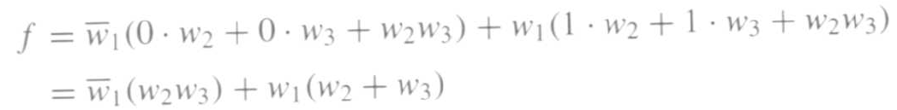
Shannon’s Expansion Theorem
(Example)
(w₁ + w₁)

Slide 52
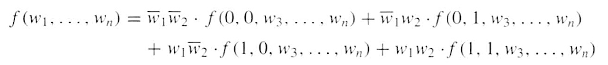
Shannon’s Expansion Theorem
(In terms of more than one variable)
This form is suitable for implementation with a 4x1 multiplexer.

Slide 53
Another Example

Slide 54

Factor and implement the following function with a 2x1 multiplexer

Slide 55
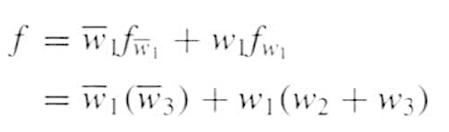
Factor and implement the following function with a 2x1 multiplexer

Slide 56
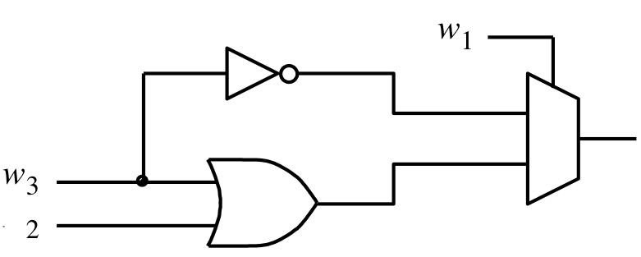
Factor and implement the following function with a 2x1 multiplexer
f
w
[ Figure 4.11a from the textbook ]

Slide 57
Factor and implement the following function with a 4x1 multiplexer

Slide 58
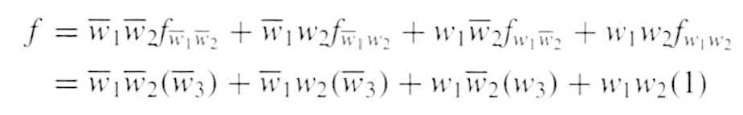
Factor and implement the following function with a 4x1 multiplexer

Slide 59
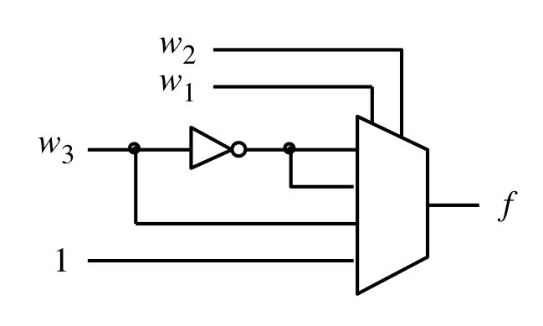
Factor and implement the following function with a 4x1 multiplexer
[ Figure 4.11b from the textbook ]

Slide 60
Yet Another Example

Slide 61

Factor and implement the following function using only 2x1 multiplexers

Slide 62
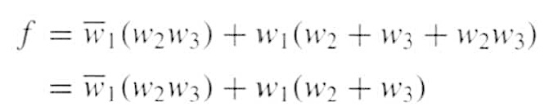
Factor and implement the following function using only 2x1 multiplexers

Slide 63


Factor and implement the following function using only 2x1 multiplexers

Slide 64
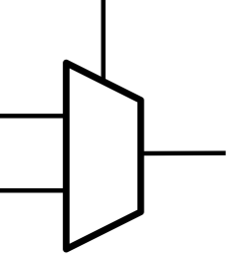
Factor and implement the following function using only 2x1 multiplexers
w₁
g
f
h

Slide 65


Factor and implement the following function using only 2x1 multiplexers

Slide 66


Factor and implement the following function using only 2x1 multiplexers

Slide 67
Factor and implement the following function using only 2x1 multiplexers
w₂
w₂
0
w₃
g
h
w₃
1

Slide 68
Finally, we are ready to draw the circuit
w₂
0
w₁
g
w₃
g
f
w₂
h
w₃
h
1

Slide 69
Finally, we are ready to draw the circuit
w₂
0
g
w₁
w₃
f
1
h

Slide 70
Finally, we are ready to draw the circuit
w
w
2
1
0
w
3
f
1
[ Figure 4.12 from the textbook ]

Slide 71
Decoders

Slide 72
2-to-4 Decoder (Definition)
Has two inputs: w₁ and w₀
Has four outputs: y₀ , y_{1 ,} y₂ , and y₃
If w₁=0 and w₀=0, then the output y₀ is set to 1
If w₁=0 and w₀=1, then the output y₁ is set to 1
If w₁=1 and w₀=0, then the output y₂ is set to 1
If w₁=1 and w₀=1, then the output y₃ is set to 1
Only one output is set to 1. All others are set to 0.

Slide 73
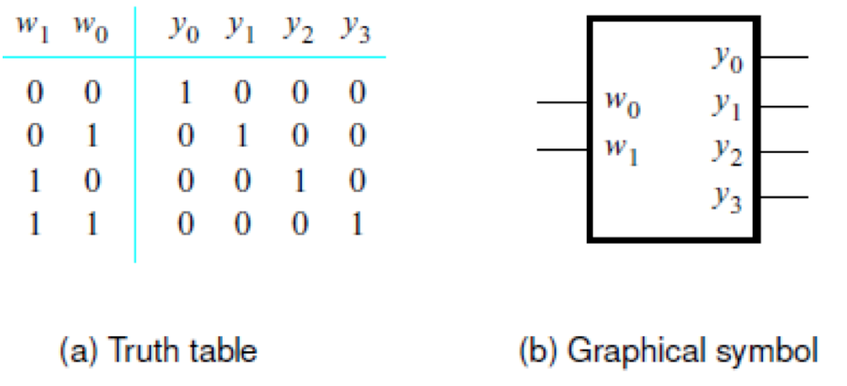
Truth Table and Graphical Symbol for a 2-to-4 Decoder
[ Figure 4.13a-b from the textbook ]

Slide 74
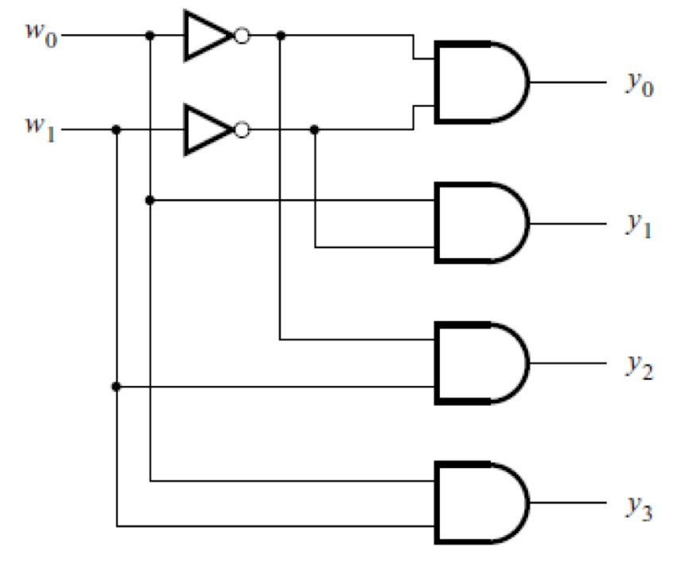
Truth Logic Circuit for a 2-to-4 Decoder
[ Figure 4.13c from the textbook ]

Slide 75
Adding an Enable Input
[ Figure 4.13c from the textbook ]

Slide 76
Adding an Enable Input
En
[ Figure 4.13c from the textbook ]

Slide 77
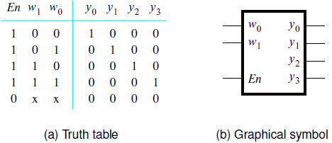
Truth Table and Graphical Symbol for a 2-to-4 Decoder with an Enable Input
[ Figure 4.14a-b from the textbook ]

Slide 78
Truth Table and Graphical Symbol for a 2-to-4 Decoder with an Enable Input
x indicates that it does not matter
what the value of this variable is
for this row of the truth table
[ Figure 4.14a-b from the textbook ]

Slide 79
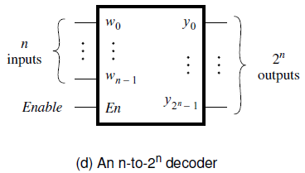
Graphical Symbol for a Binary n-to-2^{n} Decoder with an Enable Input
A binary decoder with n inputs has 2^{n} outputs
The outputs of an enabled binary decoder are “one-hot” encoded,
meaning that only a single bit is set to 1, i.e., it is hot.
[ Figure 4.14d from the textbook ]

Slide 80
How can we build larger decoders?
3-to-8 ?
4-to-16?
5-to-??

Slide 81
Hint: How did we build a 16-1 Multiplexer
s
0
s
1
w
0
w
3
w
4
s
2
s
3
w
7
f
w
8
w
11
w
12
w
15
[ Figure 4.4 from the textbook ]

Slide 82
A 3-to-8 decoder using two 2-to-4 decoders
w
w
y
y
0
0
0
0
w
w
y
y
1
1
1
1
y
y
2
w
2
2
En
y
y
3
3
En
w
y
y
4
0
0
w
y
y
5
1
1
y
y
6
2
En
y
y
7
3
[ Figure 4.15 from the textbook ]

Slide 83
A 3-to-8 decoder using two 2-to-4 decoders
w
w
y
y
0
0
0
0
w
w
y
y
1
1
1
1
y
y
2
w
2
2
En
y
y
3
3
En
w
y
y
4
0
0
w
y
y
5
1
1
y
y
6
2
En
y
y
7
3
What is this?
[ Figure 4.15 from the textbook ]

Slide 84
What is this?
w
y
0
0
En
y
1

Slide 85
A 4-to-16 decoder built using a decoder tree
w
w
y
y
0
0
0
0
w
w
y
y
1
1
1
1
y
y
2
2
En
y
y
3
3
w
y
y
0
0
4
w
y
y
1
1
5
y
y
w
2
6
2
w
y
En
y
y
0
0
3
7
w
w
y
3
1
1
y
2
y
w
y
y
En
En
w
8
3
0
0
w
y
y
1
1
9
y
y
2
10
En
y
y
3
11
w
y
y
0
0
12
w
y
y
1
1
13
y
y
2
14
En
y
y
[ Figure 4.16 from the textbook ]
3
15

Slide 86
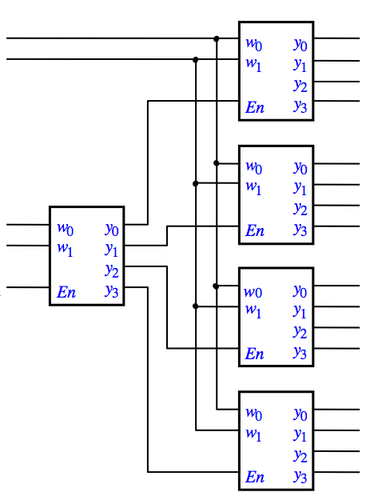
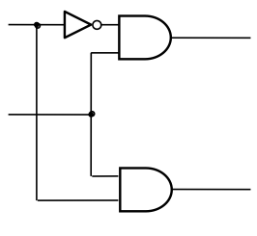
Let’s build a
5-to-32 decoder

Slide 87
Let’s build a
5-to-32 decoder
y₀ – y₁₅
En
y₁₆ – y₃₁

Slide 88
Let’s build a
5-to-32 decoder
w₀
w₁
w₂
w₃
y₀ – y₁₅
w₄
En
w₀
w₁
w₂
w₃
y₁₆ – y₃₁

Slide 89
Demultiplexers

Slide 90
1-to-4 Demultiplexer (Definition)
Has one data input line: D
Has two output select lines: w₁ and w₀
Has four outputs: y₀ , y_{1 ,} y₂ , and y₃
If w₁=0 and w₀=0, then the output y₀ is set to D
If w₁=0 and w₀=1, then the output y₁ is set to D
If w₁=1 and w₀=0, then the output y₂ is set to D
If w₁=1 and w₀=1, then the output y₃ is set to D
Only one output is set to D. All others are set to 0.

Slide 91
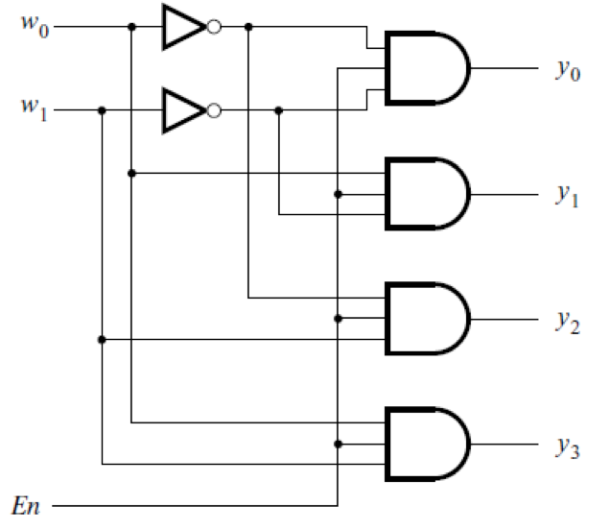
A 1-to-4 demultiplexer
built with a 2-to-4 decoder
[ Figure 4.14c from the textbook ]

Slide 92
A 1-to-4 demultiplexer
built with a 2-to-4 decoder
output
select
lines
the
four
output
lines
data
input
line
D
[ Figure 4.14c from the textbook ]

Slide 93
Multiplexers
(Implemented with Decoders)

Slide 94
A 4-to-1 multiplexer
built using a 2-to-4 decoder
w
0
w
1
s
0
w
y
0
0
s
1
w
y
f
1
1
y
w
2
2
1
En
y
3
w
3
[ Figure 4.17 from the textbook ]

Slide 95
Encoders

Slide 96
Binary Encoders

Slide 97
A 2^{n}-to-n binary encoder
w
0
y
0
2
n
n
inputs
outputs
y
n
–
1
w
2
n
–
1
[ Figure 4.18 from the textbook ]

Slide 98
A 4-to-2 binary encoder
w
w
w
w
y
y
3
2
1
0
1
0
0
0
0
1
0
0
0
0
1
0
0
1
0
1
0
0
1
0
1
0
0
0
1
1
(a) Truth table
w
0
w
1
y
0
w
2
w
y
1
3
(b) Circuit
[ Figure 4.19 from the textbook ]

Slide 99
A 4-to-2 binary encoder
w
w
w
w
y
y
3
2
1
0
1
0
0
0
0
1
0
0
0
0
1
0
0
1
0
1
0
0
1
0
1
0
0
0
1
1
(a) Truth table
?
w
0
w
1
y
0
w
2
w
y
1
3
(b) Circuit
[ Figure 4.19 from the textbook ]

Slide 100
A 4-to-2 binary encoder
w
w
w
w
y
y
3
2
1
0
1
0
0
0
0
1
0
0
0
0
1
0
0
1
0
1
0
0
1
0
1
0
0
0
1
1
(a) Truth table
It is assumed that the
inputs are one hot encoded
w
0
w
1
y
0
w
2
w
y
1
3
(b) Circuit
[ Figure 4.19 from the textbook ]

Slide 101
Priority Encoders

Slide 102
Truth table for a 4-to-2 priority encoder
w
3
w
2
w
1
w
0
y
1
y
0
z
0
0
0
0
d
d
0
0
0
0
1
0
0
1
0
0
1
x
0
1
1
0
1
x
x
1
0
1
1
x
x
x
1
1
1
[ Figure 4.20 from the textbook ]

Slide 103
Questions?

Slide 104
THE END

